Slide 1




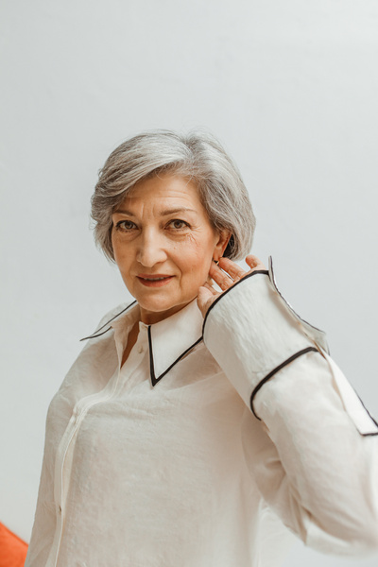
Celebrating the life of
Taylor Alonso
January 3, 1945 - August 13, 2023
Funeral Service:
August 14 | at 4:00 pm
123 Anywhere St., Any City
For directions please call Reese at
+123-456-7890

